Slide 1

Optimization Based Motion Controller Design
[CE554] Mechanical Design of Civil Robot
Team 2
20185570 - Hong Seung woo
20183633 – Choe JongHun
August 29, 2018

Slide 2
Table of Contents
Background
Course Topic
Future Work

Slide 3
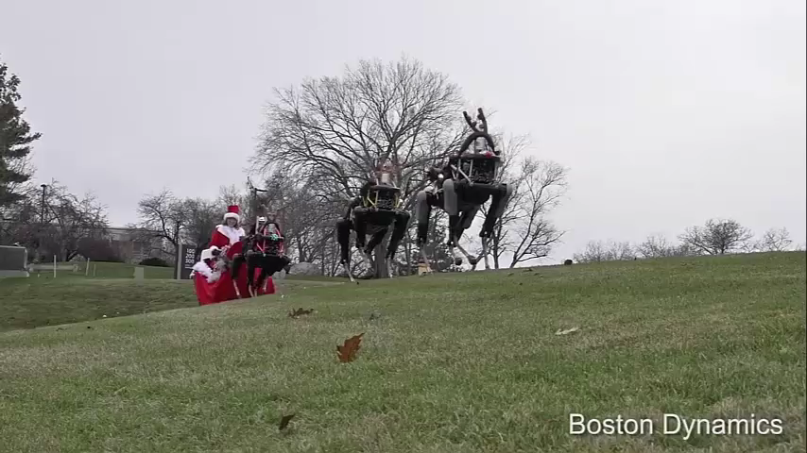
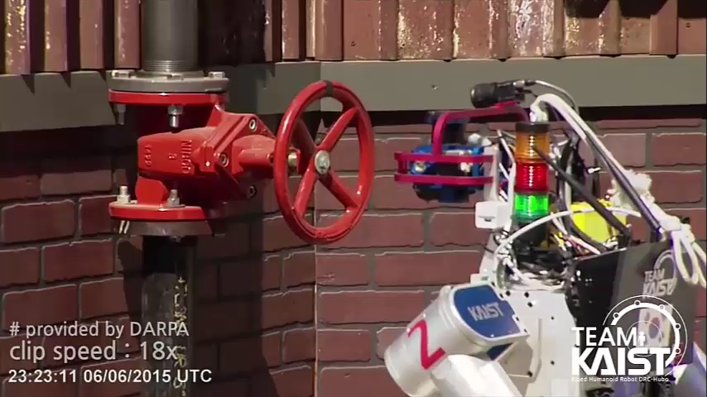
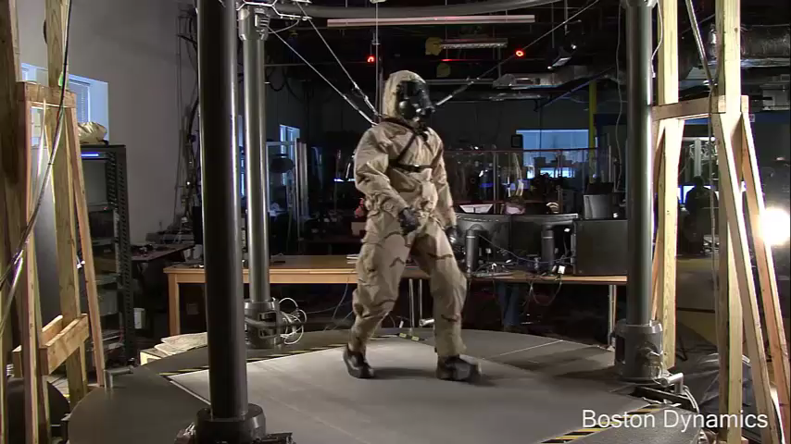
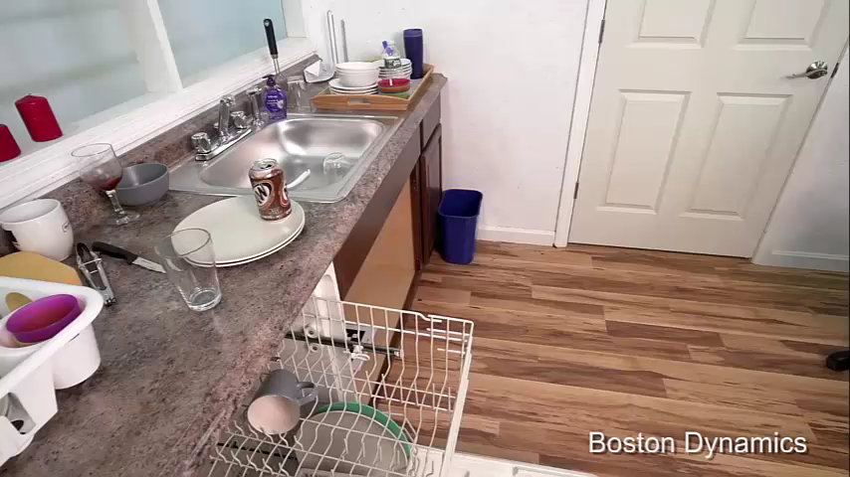
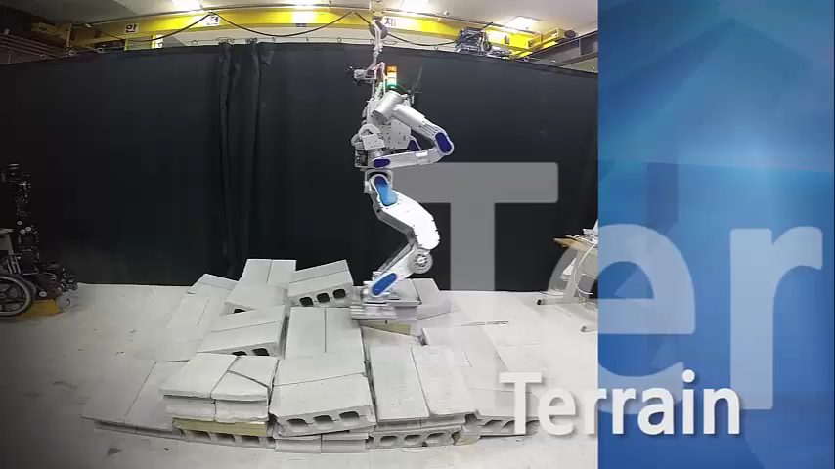
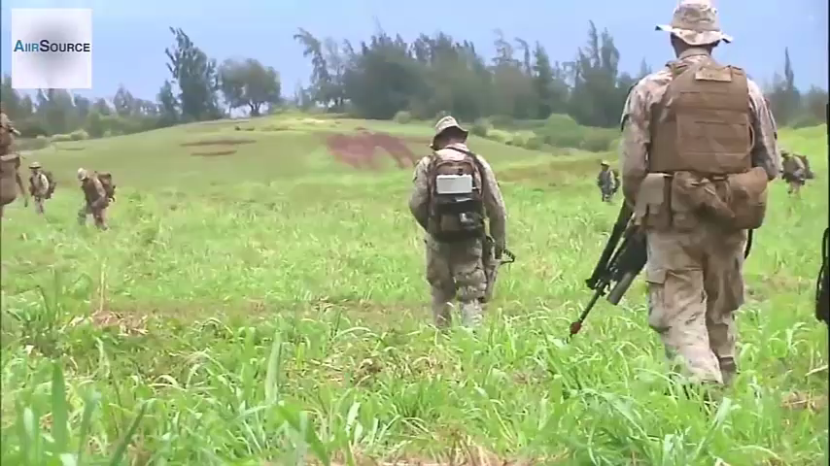
1. Background - Motivation
Applications of (Legged) Robot
- Personal service
- Disaster relief
- Military
Requirement: Reliable Motion Control
Personal Service
Disaster Relief
Military

Slide 4
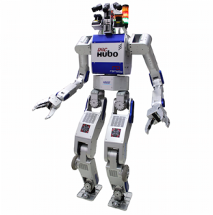
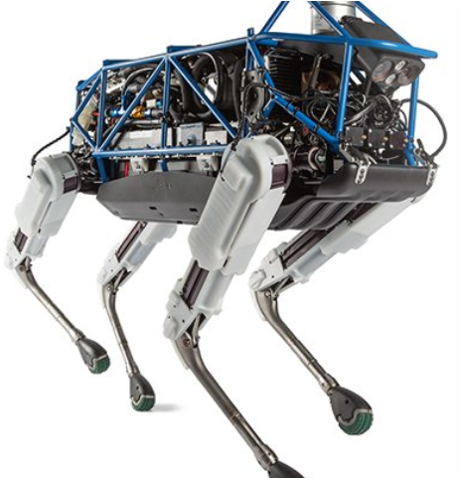
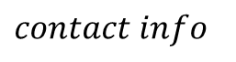
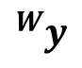
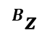
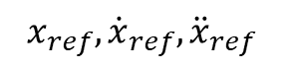
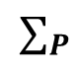
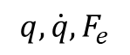
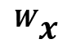
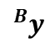
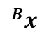

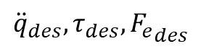
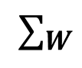
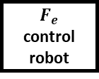
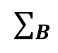
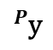
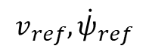
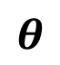
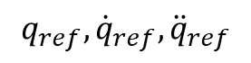
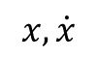
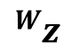
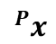
2. Course Topic – Trajectory Optimization
Block diagram of motion control framework
$$v_{ref},{\dot{ψ}}_{ref}$$
$contact info$
Reference Generator
$$x, \dot{x}$$
$$x_{ref},{\dot{x}}_{ref},{\ddot{x}}_{ref}$$
Inverse Kinematics
State
Estimator
$$q_{ref},{\dot{q}}_{ref},{\ddot{q}}_{ref}$$
$${}_{ }^{W}z$$
Optimization Based Motion Controller
$${}_{ }^{W}y$$
$${}_{ }^{W}x$$
$$∑_{W}$$
$$∑_{B}$$
$${}_{ }^{B}{z }$$
$${\ddot{q}}_{des}, τ_{des}, {F_{e}}_{des}$$
$${}_{ }^{B}{y }$$
$${}_{ }^{B}{x }$$
$$φ$$
Plant
Position control robot
Torque
control robot
$$F_{e}$$
control robot
$${}_{ }^{P}{\text{y} }$$
$${}_{ }^{P}{x }$$
$$∑_{P}$$
$$θ$$
$$q, \dot{q},F_{e}$$

Slide 5
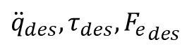
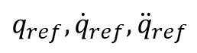
2. Course Topic – Trajectory Optimization
Block diagram of motion control framework
$$v_{ref},{\dot{ψ}}_{ref}$$
$contact info$
Reference Generator
Optimization Based
Motion Controller
$$q_{ref},{\dot{q}}_{ref},{\ddot{q}}_{ref}$$
$$x, \dot{x}$$
$$x_{ref},{\dot{x}}_{ref},{\ddot{x}}_{ref}$$
Inverse Kinematics
Constraints
Desired behaviors
State
Estimator
$$q_{ref},{\dot{q}}_{ref},{\ddot{q}}_{ref}$$
Optimization Based Motion Controller
QP solver
$${\ddot{q}}_{des}, τ_{des}, {F_{e}}_{des}$$
Plant
Position control robot
Torque
control robot
$$F_{e}$$
control robot
$${\ddot{q}}_{des}, τ_{des}, {F_{e}}_{des}$$
$$q, \dot{q},F_{e}$$

Slide 6
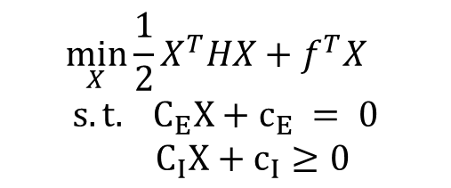
2. Course Topic – Trajectory Optimization
Quadratic Programming
- Optimize the general cost function
$$\min_{X}{\frac{1}{2}X^{T}HX+f^{T}X}$$
$$s.t. C_{E}X+c_{E} = 0$$
$C_{I}X+c_{I}≥0$
Cost function
Cartesian space acceleration
Joint space acceleration
Weight distribution
Center of Pressure tracking
Direct tracking and regularization
Equality constraint
Dynamics
Contact constraint
Inequality constraint
Friction cone
Center of Pressure

Slide 7
3. Future Work
Optimization based motion controller design:
- Model: Full model or Reduced model
- State: Full state or Reduced state
- Cost function: desired behaviors to be optimized
- Equality and inequality constraint: actuator bounds, no foot slipping
Select appropriate Quadratic Programming solver
Test on full-body simulator

Slide 8


Slide 9
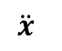
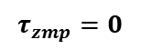
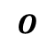
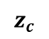
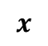

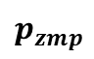
Appendix
Reduced model vs. Full model
Reduced-Model Controller
Full-Model Controller
$$\ddot{x}$$
$$M$$
$$z_{c}$$
$$τ_{zmp}=0$$
$$O$$
$$p_{zmp}$$
$$x$$

